Slide 1

Introduction to Software Engineering (ISE102) Tutorial Week 1

Slide 2
Welcome to 32555 – Fundamentals of Software Development
Your Teaching Team:
Dr. Yining Hu – Subject Coordinator
Dr. Farshid Keivanian – Tutor
Dr. Hasan Khattak – Tutor
Xiaojie (Zoe) Lin – Tutor

Slide 3
Welcome to 32555 – Fundamentals of Software Development
What You’ll Learn:
Fundamentals of software development
Object-Oriented Programming (OOP) using Java or Python
UML modeling & GUI applications
Software testing, collaboration, and version control (Git)
Tools Used: Visual Paradigm, Git, BlueJ / Eclipse / VSCode, Python 3.8+, JavaFX / Tkinter

Slide 4
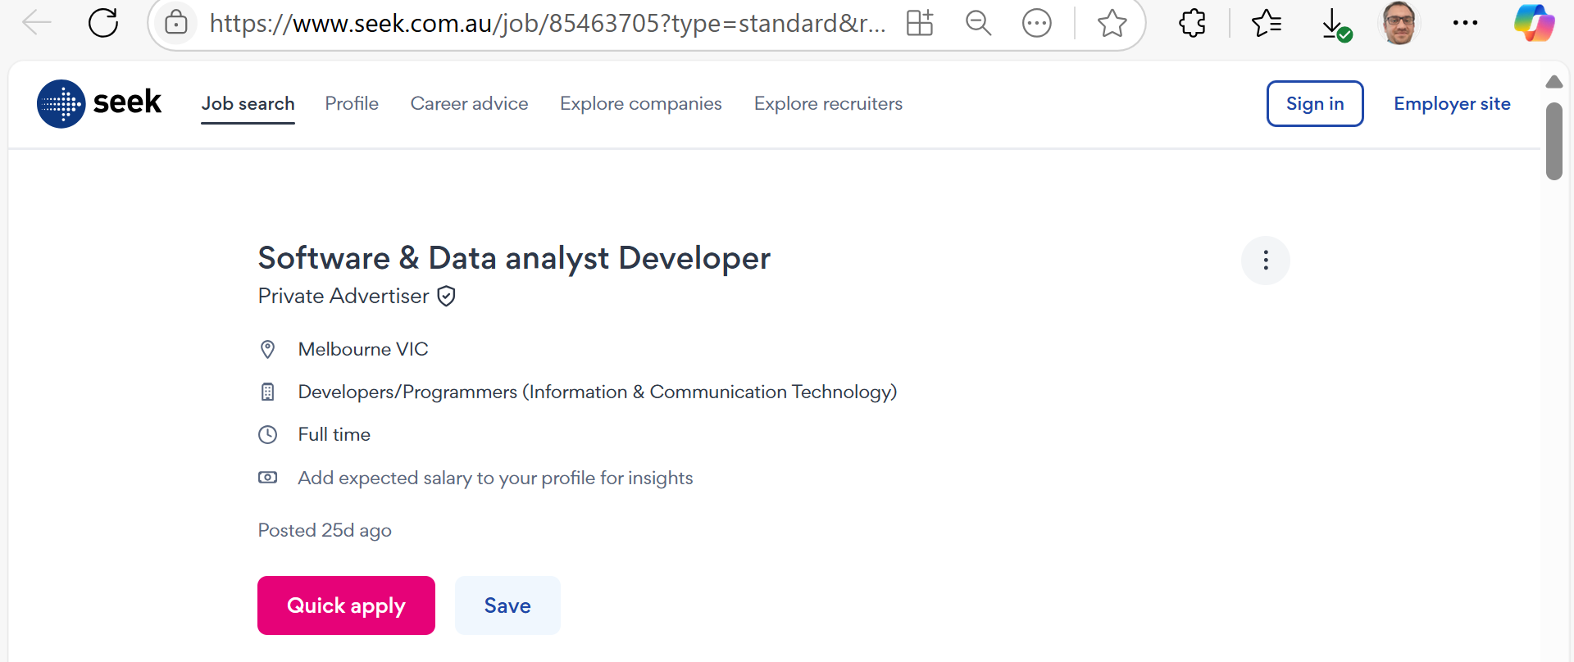
Career Opportunities & Certifications
Job Roles in Australia
Software & Data Analyst Developer

Slide 5
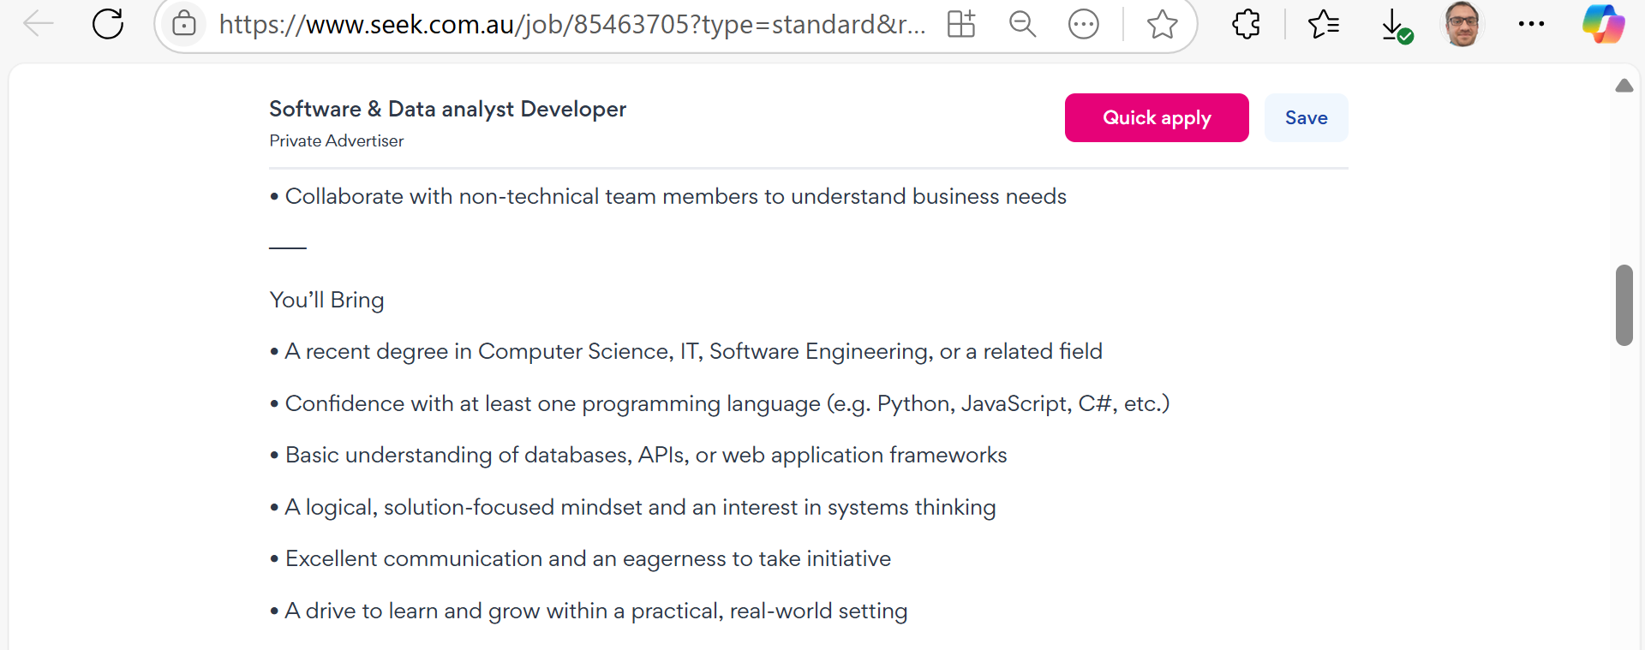
Career Opportunities & Certifications
Job Roles in Australia
Software & Data Analyst Developer

Slide 6
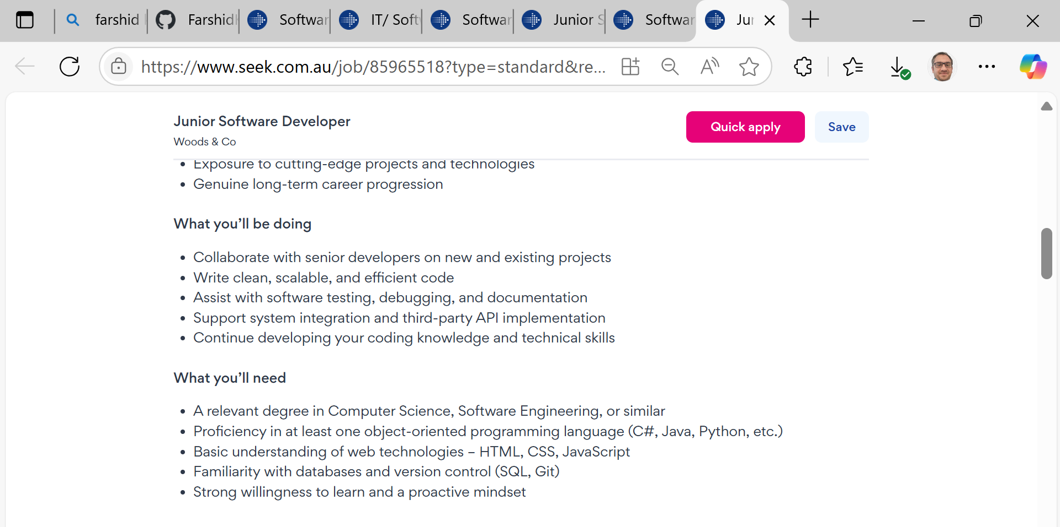
Career Opportunities & Certifications
Job Roles in Australia
Junior Software Developer

Slide 7
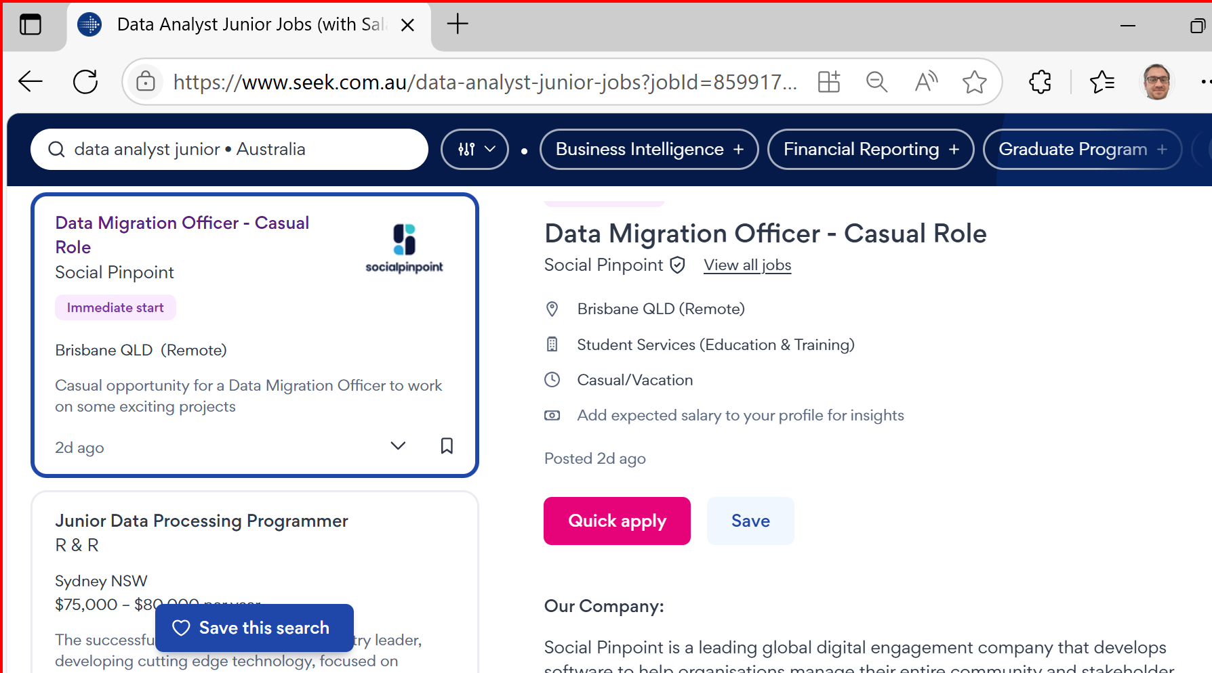
Career Opportunities & Certifications
Data Analyst: Interpret complex datasets to inform business decisions.

Slide 8
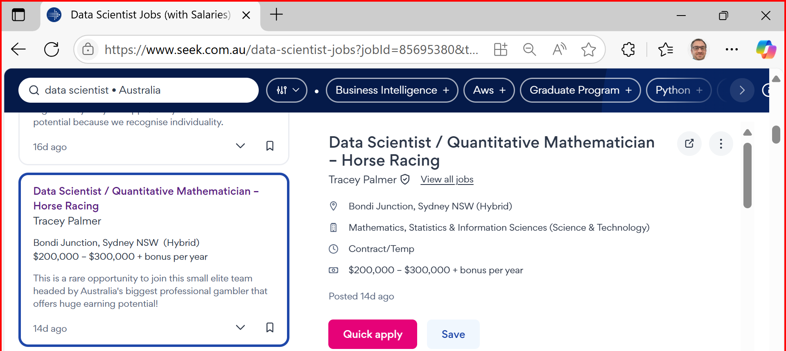
Career Opportunities & Certifications
Data Scientist Develop predictive models and uncover insights using ML & deep learning.

Slide 9
Career Opportunities & Certifications
Business Intelligence Analyst Translate analytics into strategic planning using BI tools.
Machine Learning Engineer Build and deploy scalable ML models in real-time systems.

Slide 10
Career Opportunities & Certifications
AI Solutions Consultant Advise on integrating AI into business operations.
Big Data Analyst Analyse large-scale datasets from cloud or distributed sources.
Advanced Analytics Consultant Design prescriptive models to solve industry-specific problems.

Slide 11
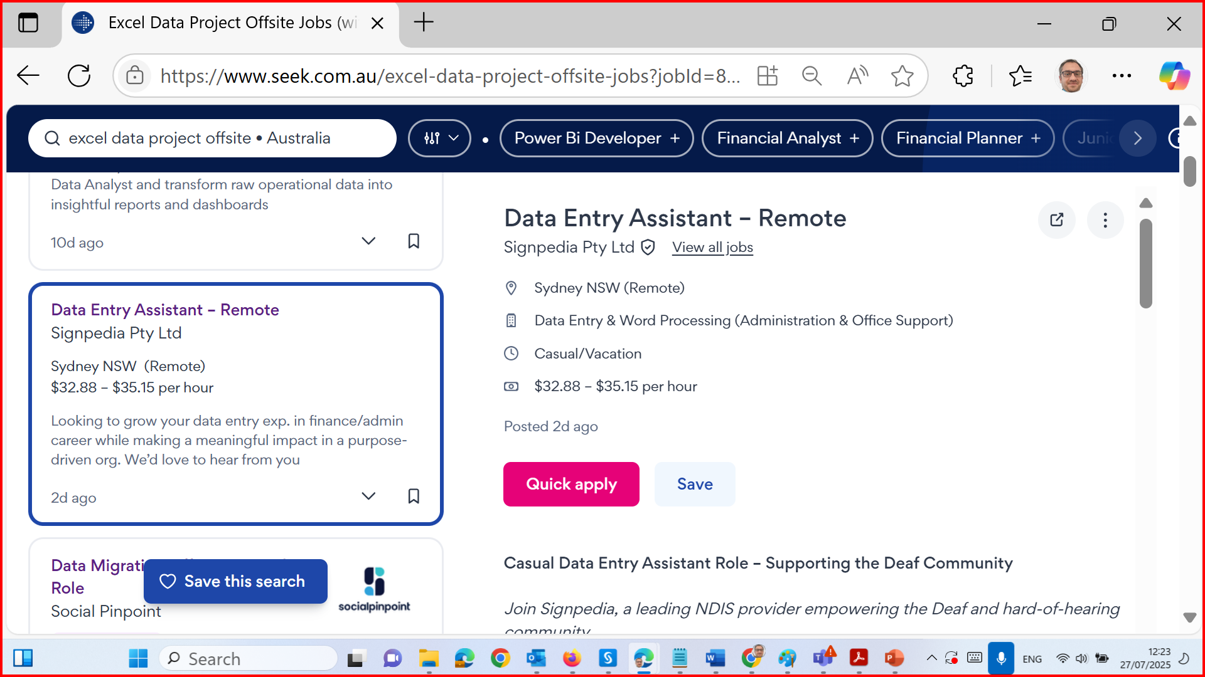
Career Opportunities & Certifications

Slide 12
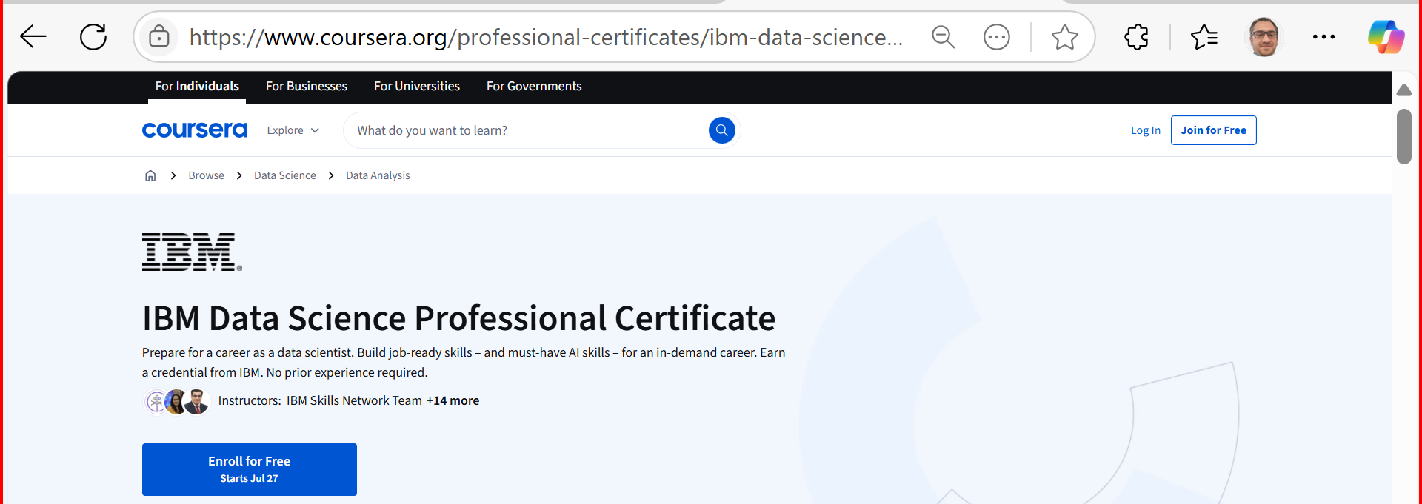
Career Opportunities & Certifications
Relevant Certifications (Optional/Recommended)
Enhance your employability with these recognised certifications:
IBM Data Science Professional Certificate (Coursera)

Slide 13
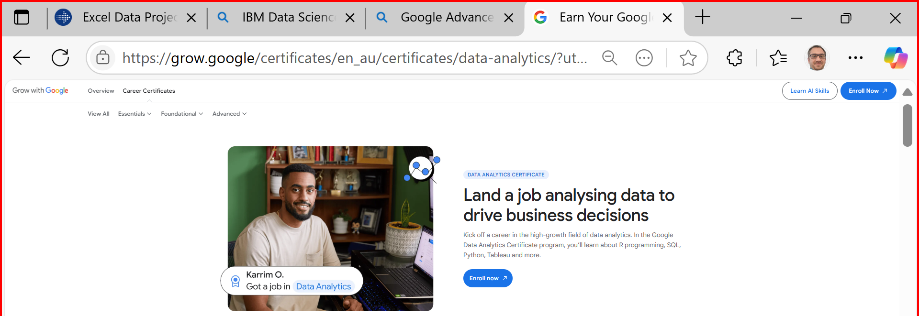
Career Opportunities & Certifications
Google Advanced Data Analytics Certificate

Slide 14
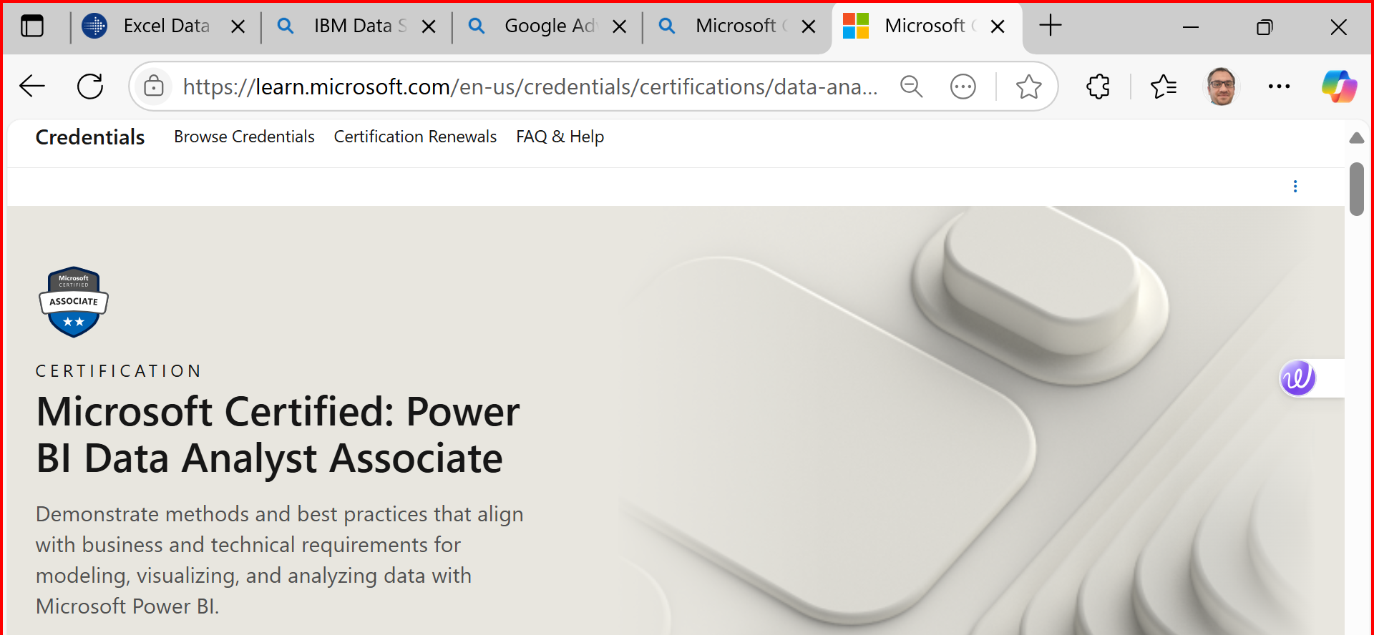
Career Opportunities & Certifications
Microsoft Certified: Data Analyst Associate (Power BI)

Slide 15
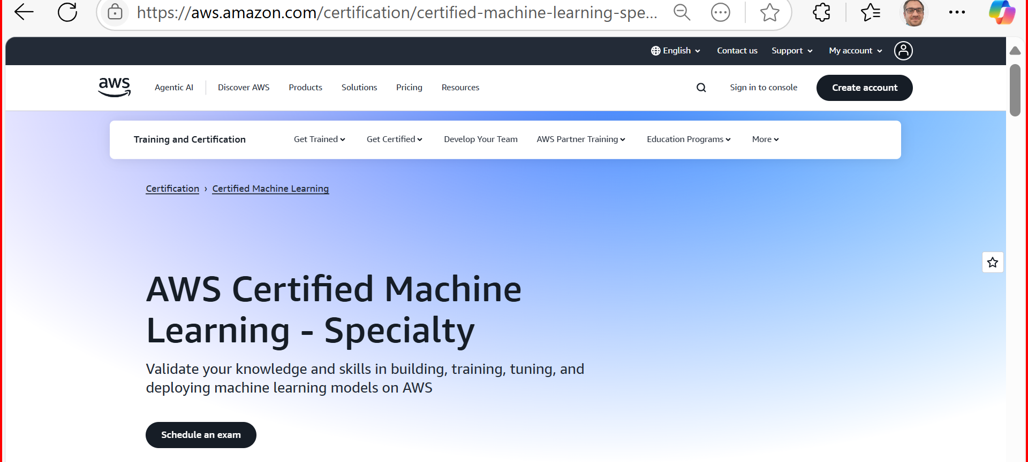
Career Opportunities & Certifications
AWS Certified Machine Learning – Specialty
SAS Certified Advanced Analytics Professional
Databricks Certified Data Engineer Associate

Slide 16
Week 1 Expectations
Welcome everyone to 32555 – Fundamentals of Software Development. Whether you’ve coded before or this is your first time, this subject is designed to give you the foundations of software engineering using either Python or Java.
We’ll teach you how to think like a developer: analyze user needs, model your solution, write working code, test it, and work in a team using Git.
Please choose either Python or Java this week — you only need to use one language for the rest of the trimester. Labs, quizzes, and assessments will align with your choice.

Slide 17
Week 1 Expectations
By next week, I want you to have your IDE set up, Git configured, and be comfortable with UML tools.
Remember: don't just aim to pass — aim to build something meaningful and reusable for your portfolio.
I’ll be here to support you throughout. Let’s make it a great semester!

Slide 18
Week 1 Expectations
As a student, you are expected to:
Attend weekly 2-hour tutorials (on campus)
Watch online lectures and demos before each lab
Complete all practice quizzes and assignments on time
Communicate professionally via Canvas Inbox
Actively participate in group activities and contribute equally

Slide 19
Week 1 Expectations
Avoid:
Leaving labs or assignments until the last minute
Ignoring Canvas announcements or deadlines
Submitting without proper version control or testing

Slide 20
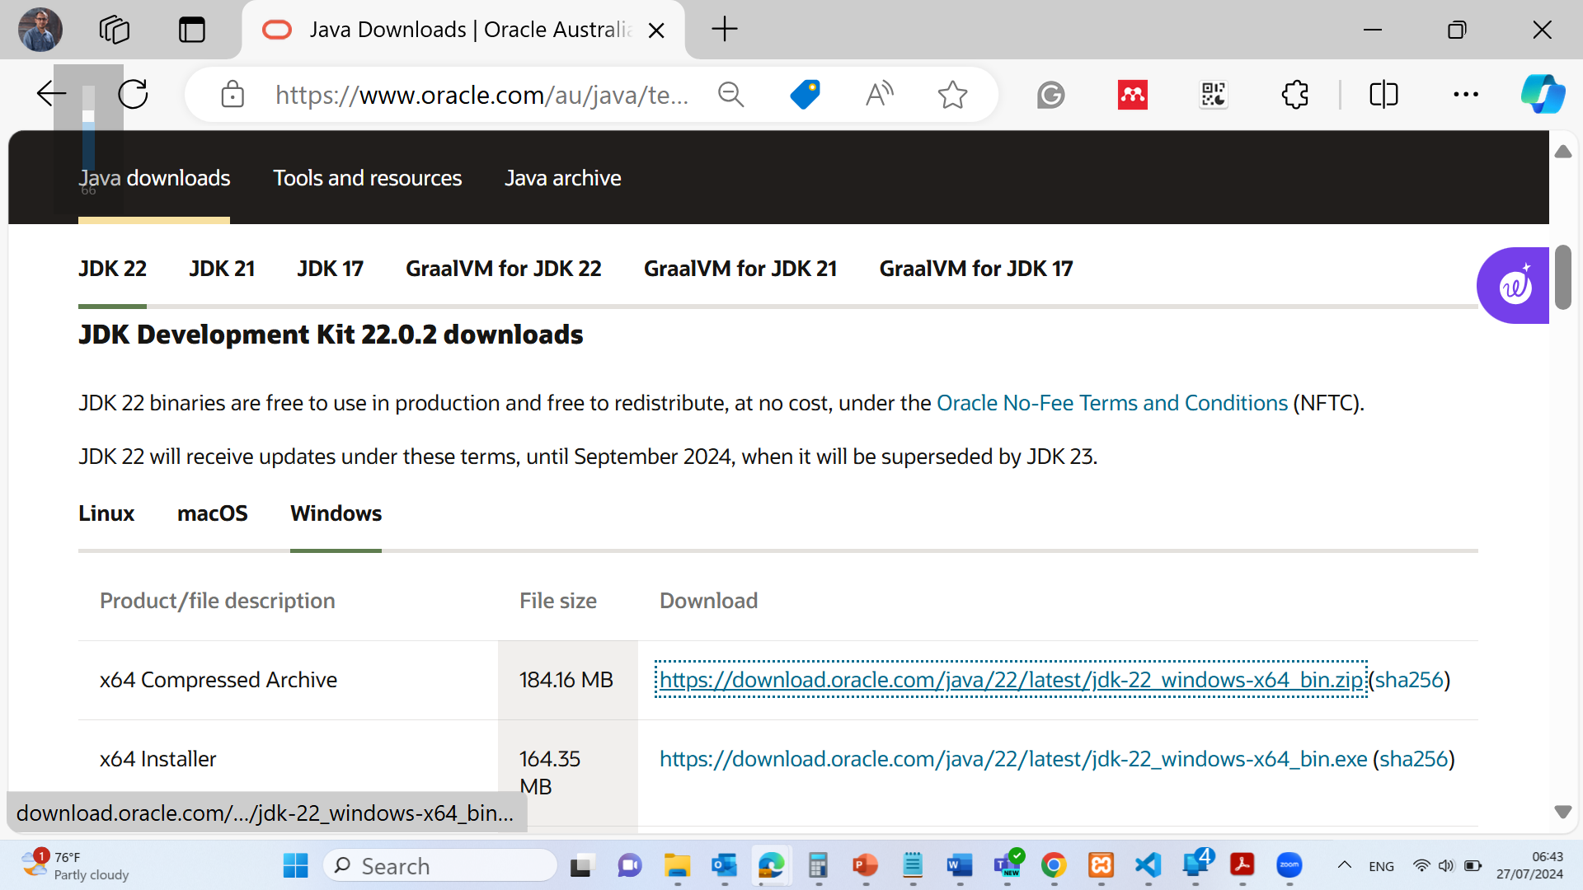
Java Installation:
Download and install the idk package https://www.oracle.com/au/java/technologies/downloads/#jdk22-windows

Slide 21
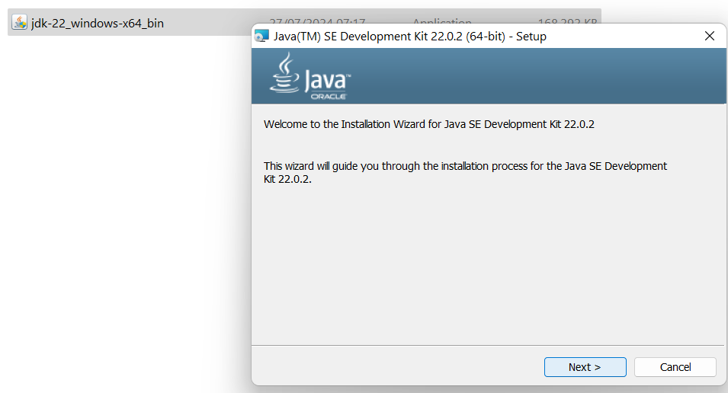
Java Installation:
Download and install the idk package https://www.oracle.com/au/java/technologies/downloads/#jdk22-windows

Slide 22
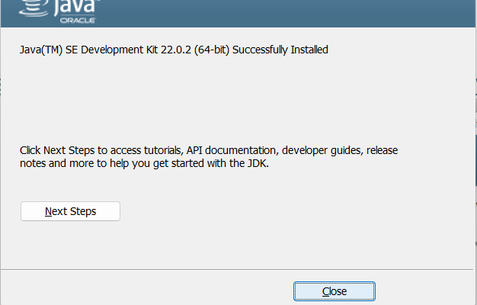
Java Installation:
Download and install the idk package https://www.oracle.com/au/java/technologies/downloads/#jdk22-windows

Slide 23
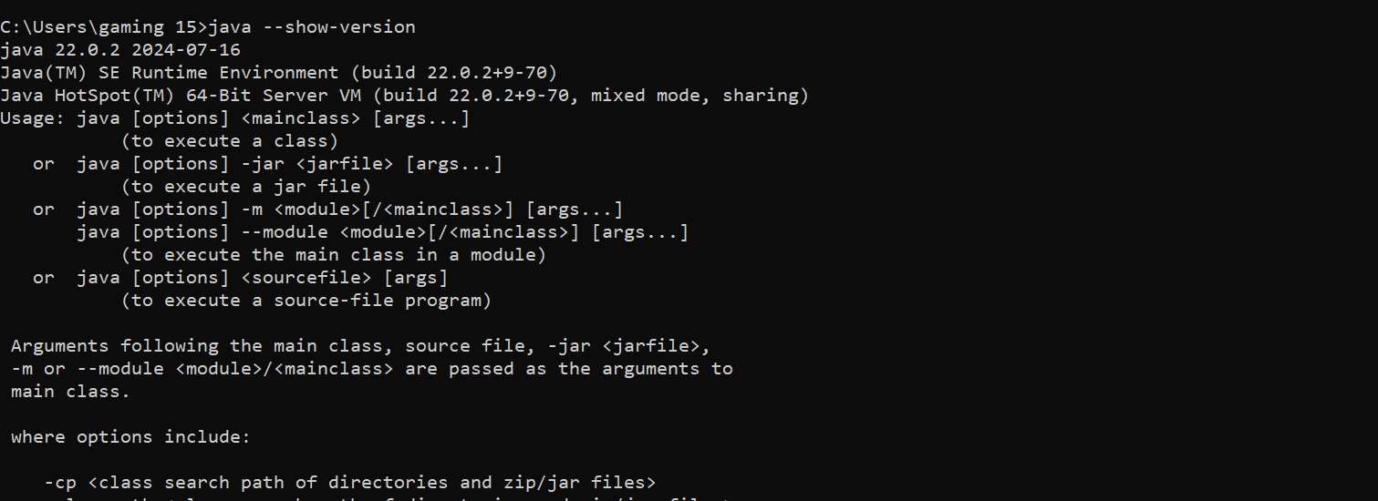
Java Installation:
Command Prompt Windows / Terminal in MAC: java –show-version

Slide 24
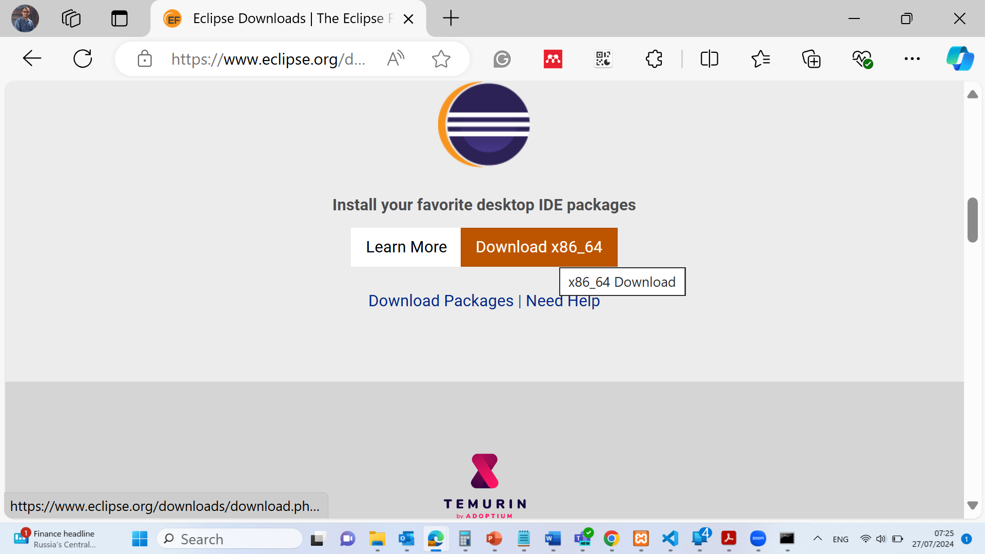
Java Installation:
Download Eclipse Software https://www.eclipse.org/downloads/

Slide 25
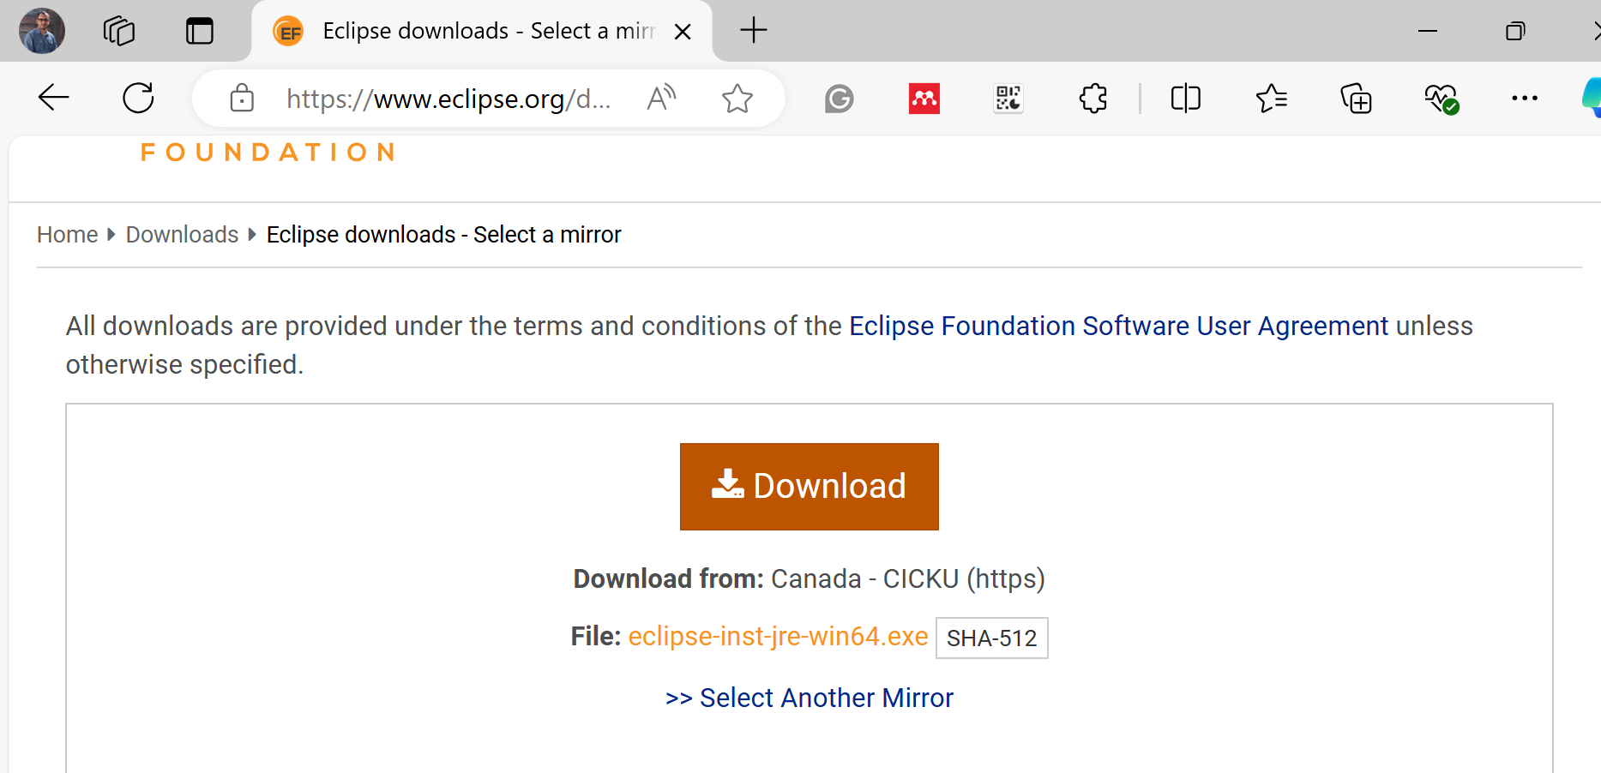
Java Installation:
Download Eclipse Software https://www.eclipse.org/downloads/

Slide 26
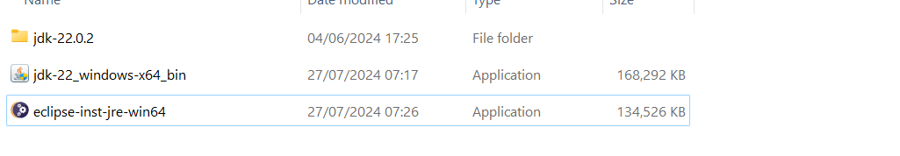
Java Installation:
Install Eclipse Software https://www.eclipse.org/downloads/

Slide 27
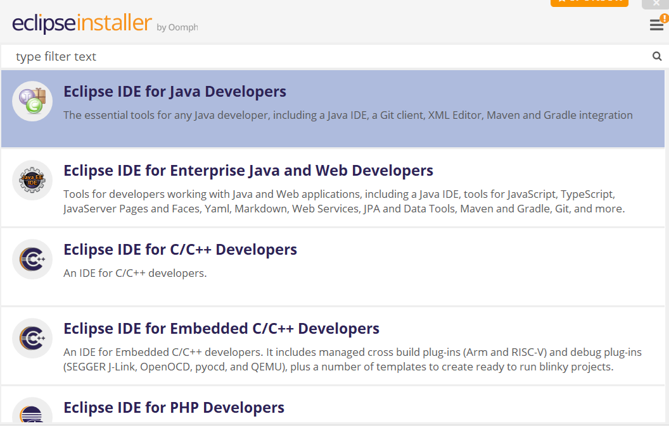
Java Installation:
Install Eclipse Software https://www.eclipse.org/downloads/

Slide 28
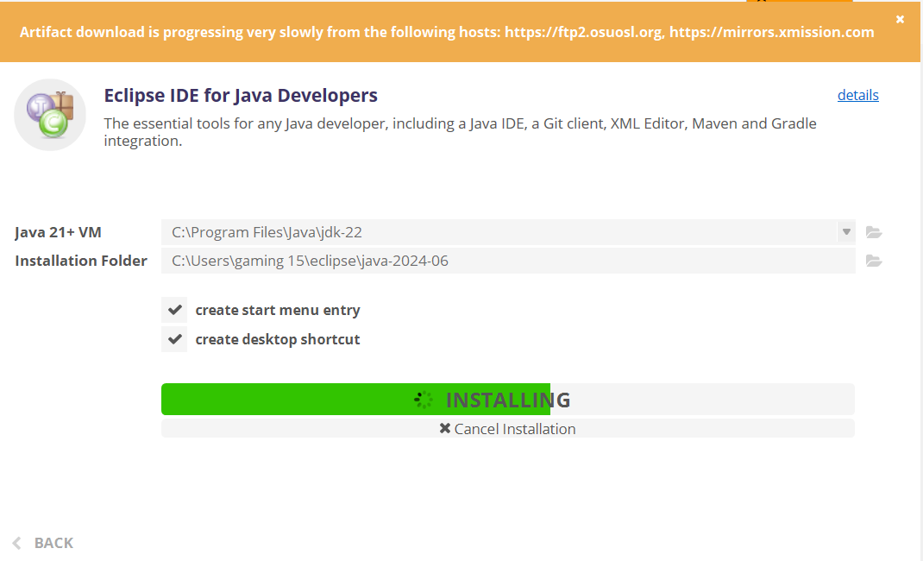
Java Installation:
Install Eclipse Software https://www.eclipse.org/downloads/

Slide 29
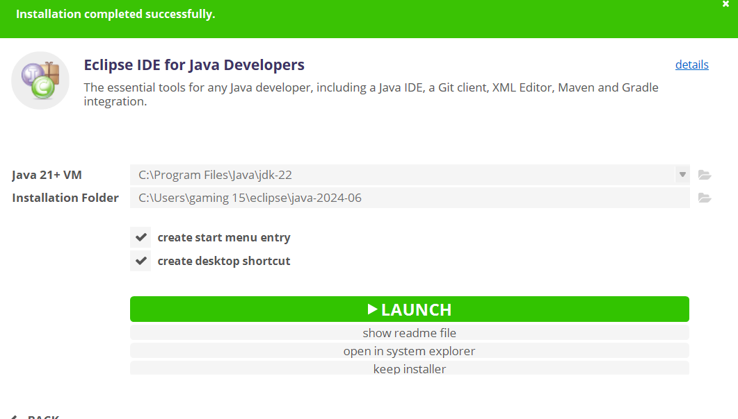
Java Installation:
Install Eclipse Software https://www.eclipse.org/downloads/

Slide 30
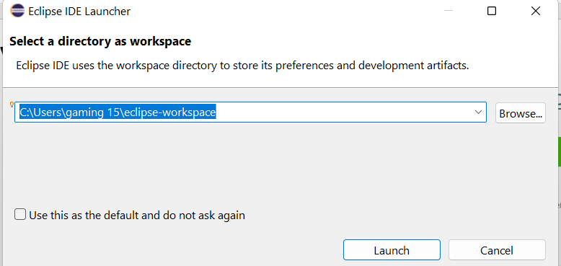
Java Installation:
Install Eclipse Software https://www.eclipse.org/downloads/

Slide 31
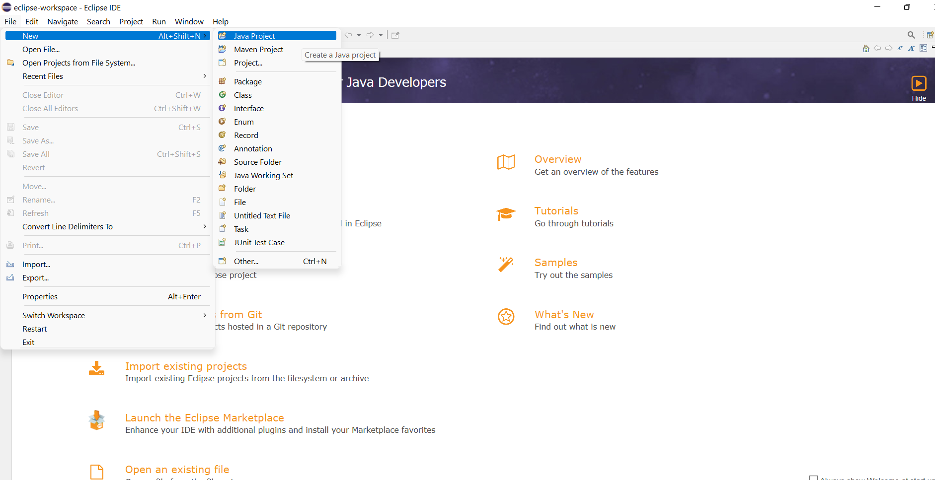
Java Installation:
Install Eclipse Software https://www.eclipse.org/downloads/

Slide 32
A First Java Program
We present a simple Java program (Listing 1.1) that prints "Welcome to Java!" to the console. We demonstrate the basic structure of a Java program, including the class definition and the main method, which is the entry point of any Java application.

Slide 33
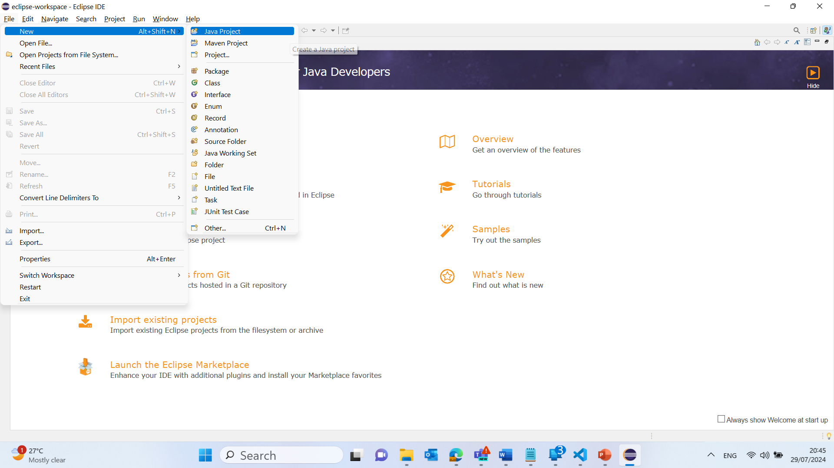
Simple User Input and Output Analysis in Java
1. Click on "Create a new Java project":
This will open a new window where you can set up your project.

Slide 34
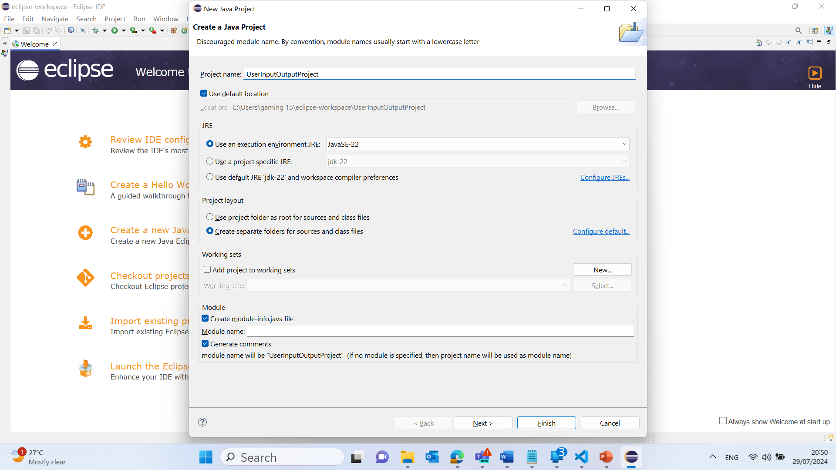
Simple User Input and Output Analysis in Java
2. Set up the new project:
Enter a project name (e.g., Welcome).
Click Finish.

Slide 35
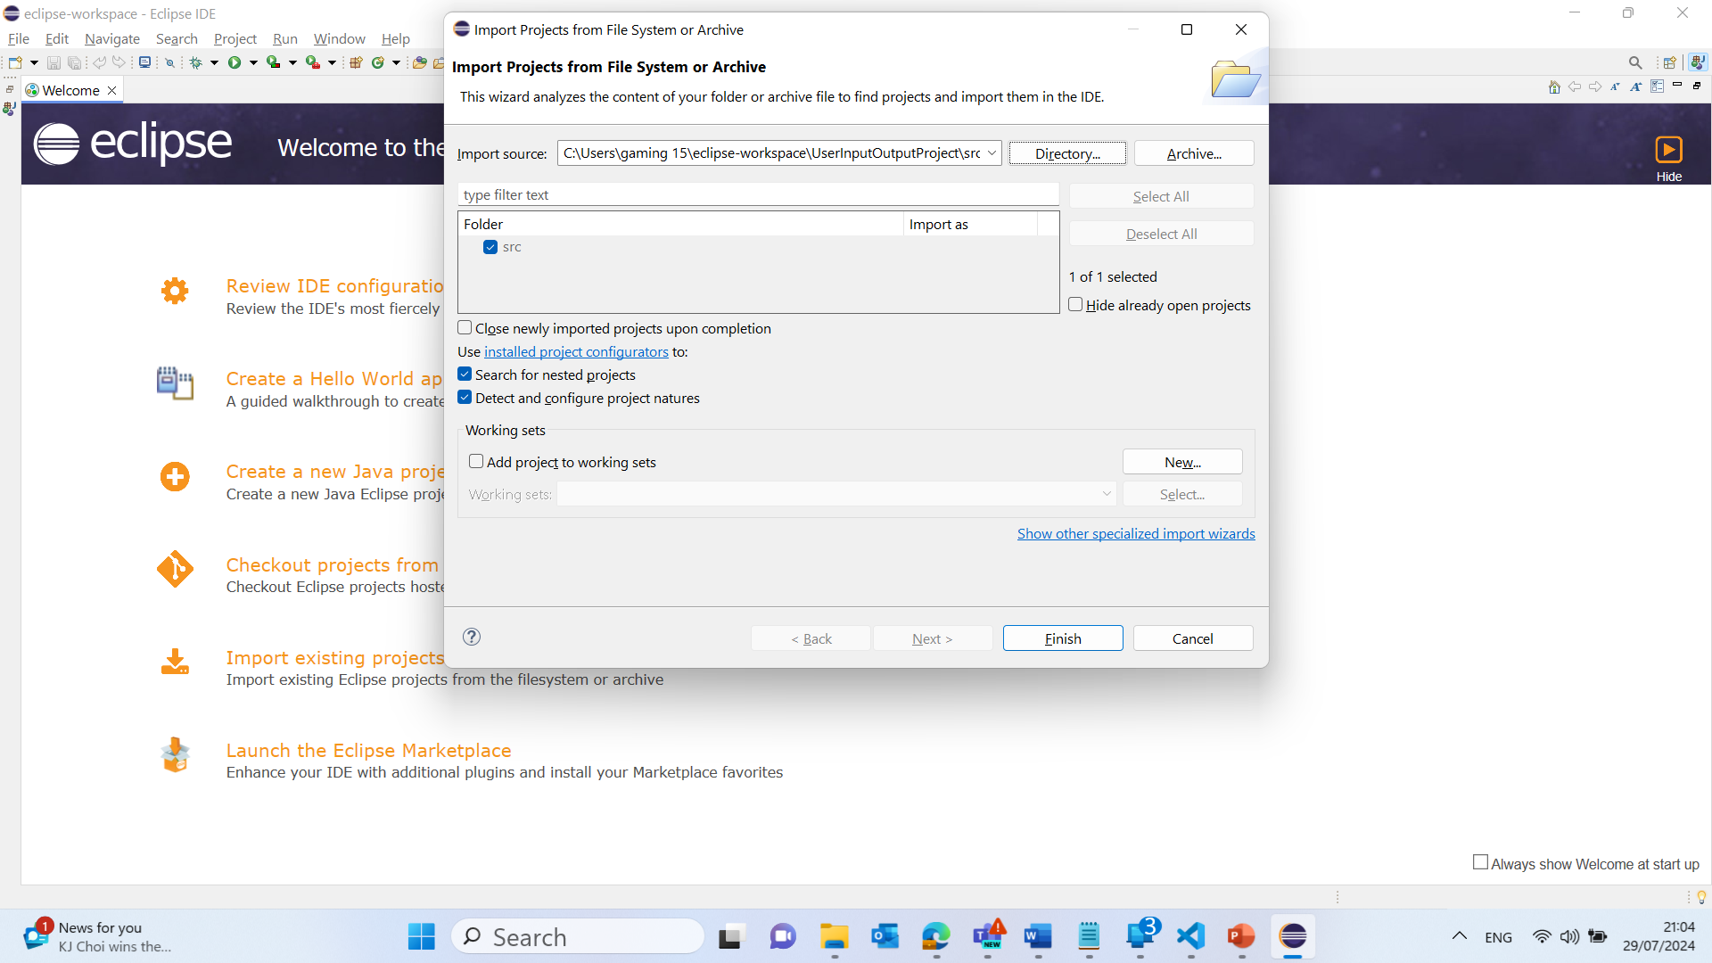
Simple User Input and Output Analysis in Java
2. Set up the new project:
Enter a project name (e.g., Welcome).
Click Finish.

Slide 36
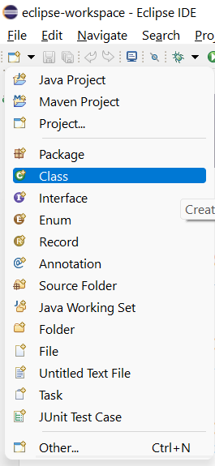
Simple User Input and Output Analysis in Java
3. Create a new Java class:
File >> Open Projects from File Systems >> Directory >> Choose the Direct where the Project is Saved ‘e.g. C:\Users\gaming 15\eclipse-workspace\Welcome\src’
Click on Select Folder
Select New > Class.

Slide 37
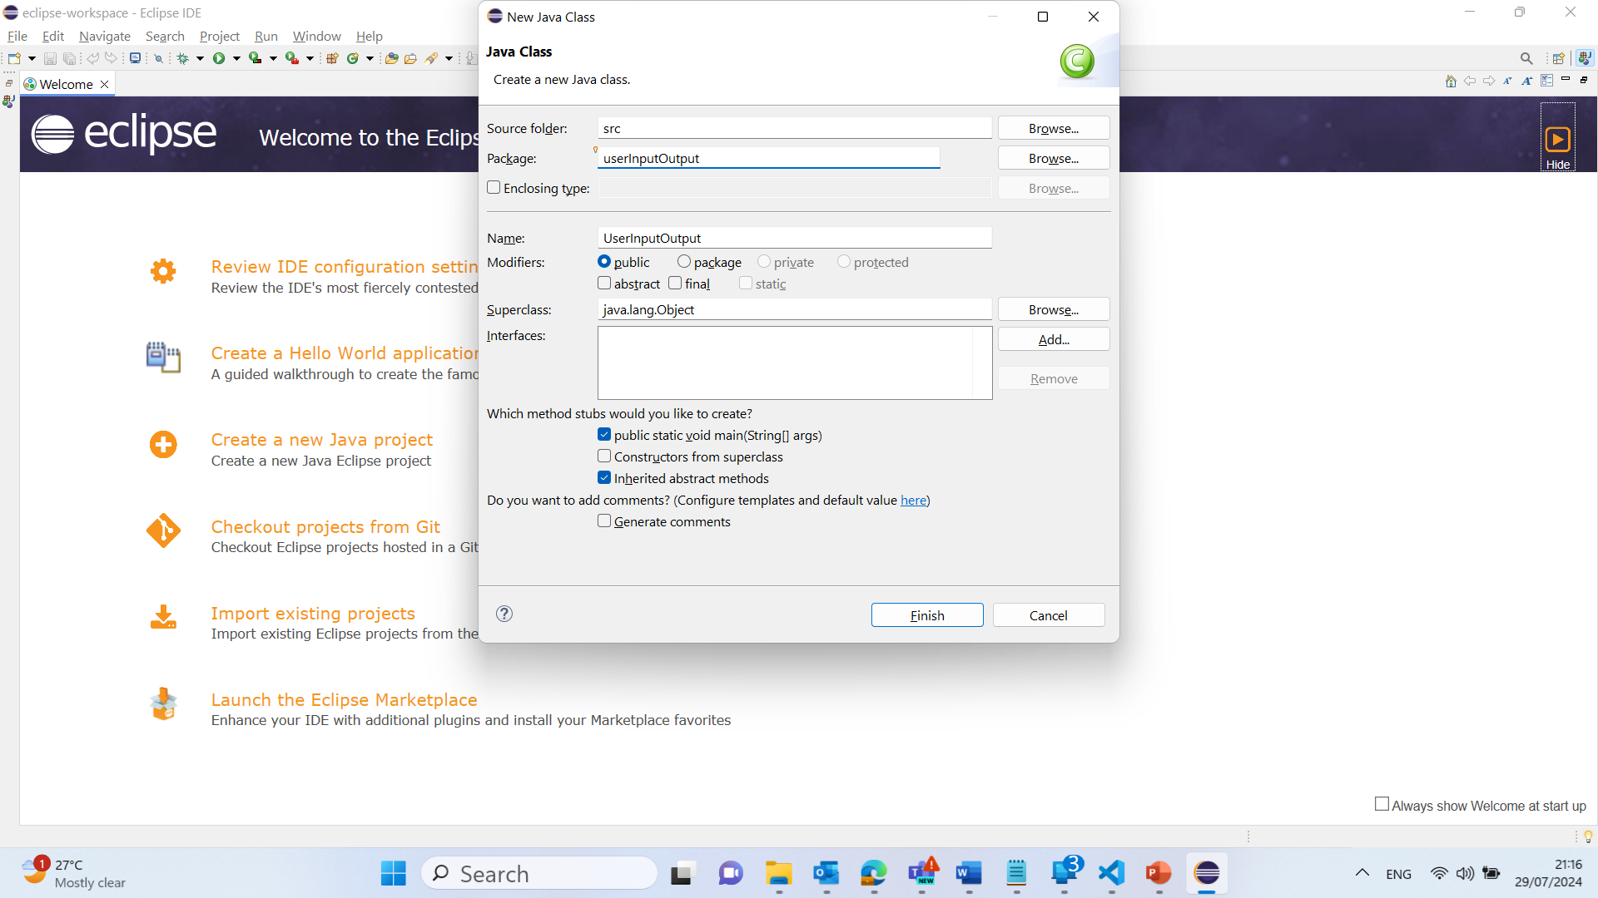
Simple User Input and Output Analysis in Java
Enter a class name (e.g., Welcome).
Ensure the public static void main(String[] args) option is checked.
Click Finish.
Click on Hide (Front Page)

Slide 38
Simple User Input and Output Analysis in Java
4. Write your Java code:
Copy and paste the code into the newly created class:

Slide 39
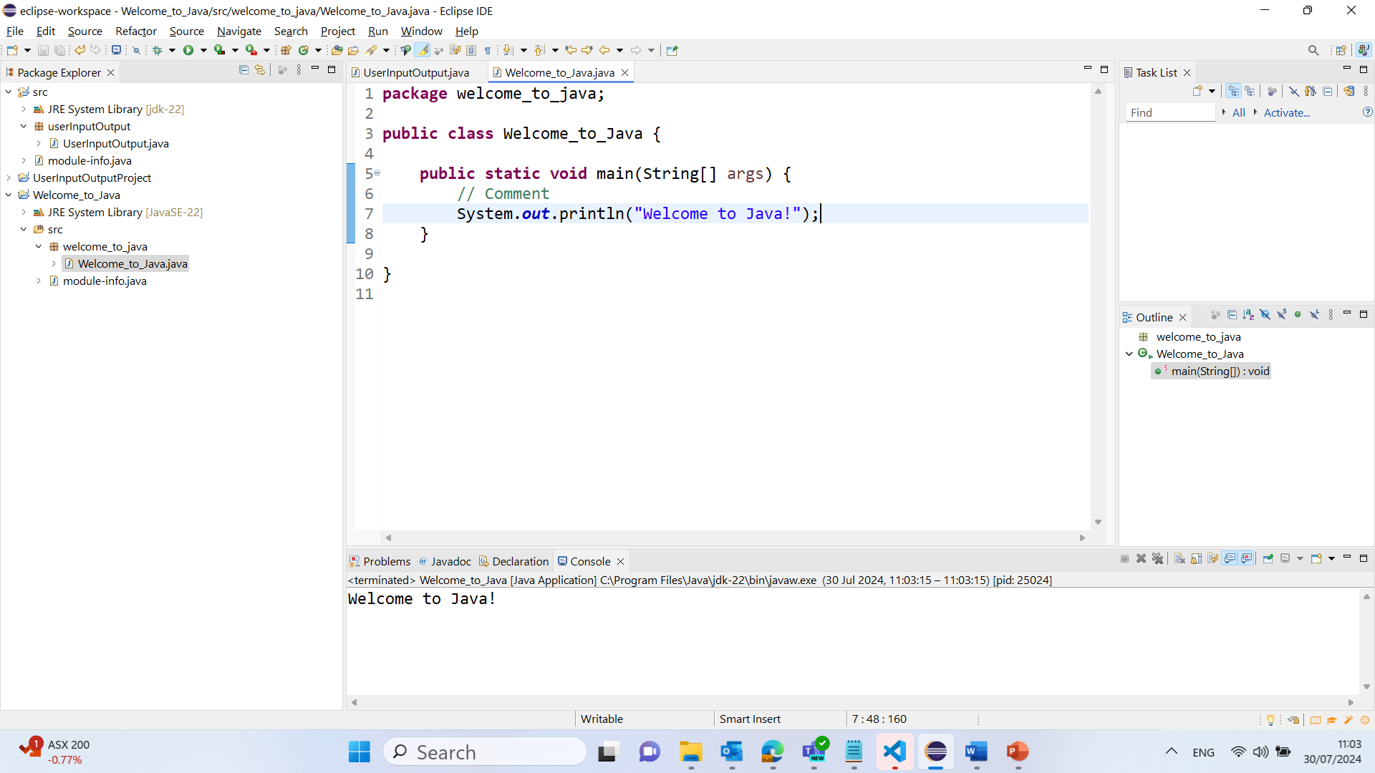
package welcome_to_java;
public class Welcome_to_Java {
public static void main(String[] args) {
// Comment
System.out.println("Welcome to Java!");
}
}
public class Welcome: Defines a public class named Welcome.
public static void main(String[] args): The main method is the entry point of the program.
System.out.println("Welcome to Java!");: Prints the message "Welcome to Java!" to the console.
This simple program introduces you to the fundamental components of a Java program, such as classes, methods, and the standard output function. By running this program, you get a practical understanding of how Java code is structured and executed.

Slide 40
Simple User Input and Output Analysis in Java
1. Click on "Create a new Java project":
This will open a new window where you can set up your project.

Slide 41
Simple User Input and Output Analysis in Java
2. Set up the new project:
Enter a project name (e.g., UserInputOutputProject).
Click Finish.

Slide 42
Simple User Input and Output Analysis in Java
2. Set up the new project:
Enter a project name (e.g., UserInputOutputProject).
Click Finish.

Slide 43
Simple User Input and Output Analysis in Java
3. Create a new Java class:
File >> Open Projects from File Systems >> Directory >> Choose the Direct where the Project is Saved ‘e.g. C:\Users\gaming 15\eclipse-workspace\UserInputOutputProject\src’
Click on Select Folder
Select New > Class.

Slide 44
Simple User Input and Output Analysis in Java
Enter a class name (e.g., UserInputOutput).
Ensure the public static void main(String[] args) option is checked.
Click Finish.
Click on Hide (Front Page)

Slide 45
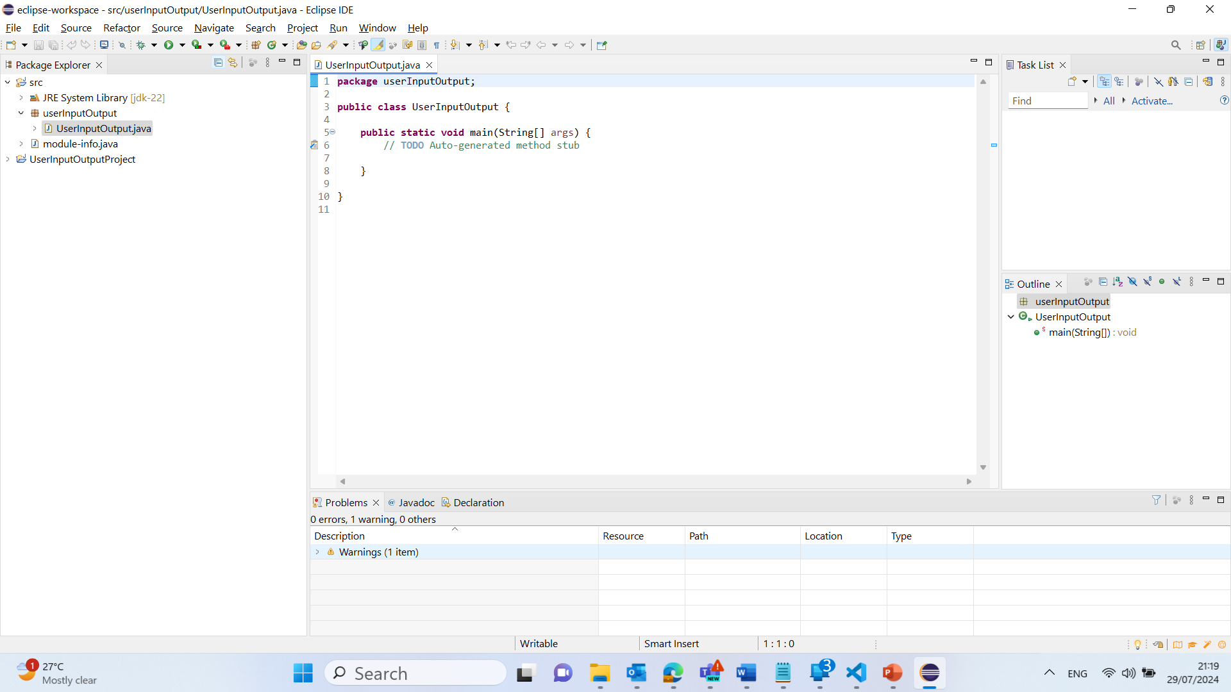
Simple User Input and Output Analysis in Java
4. Write your Java code:
Copy and paste the code into the newly created class:

Slide 46
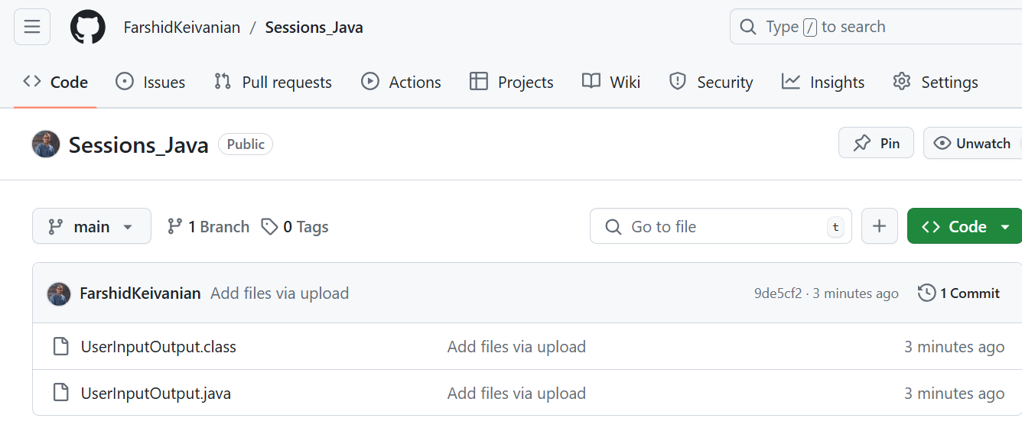
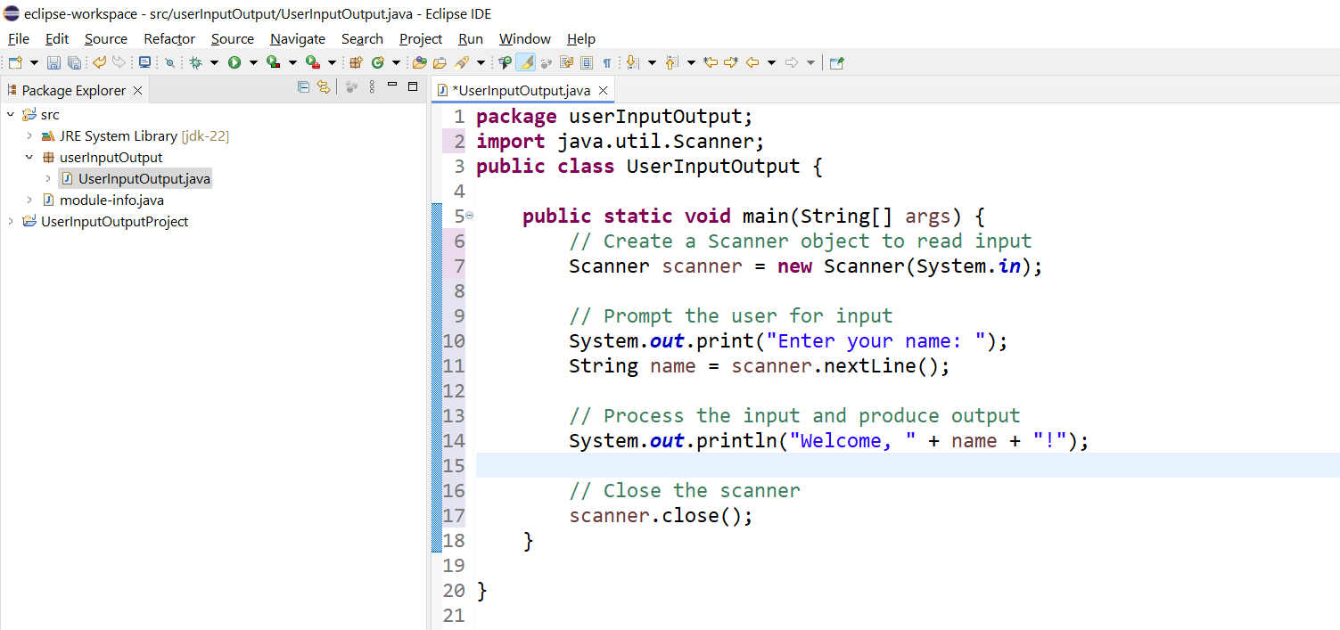
package userInputOutput;
import java.util.Scanner;
public class UserInputOutput {
public static void main(String[] args) {
// Create a Scanner object to read input
Scanner scanner = new Scanner(System.in);
// Prompt the user for input
System.out.print("Enter your name: ");
String name = scanner.nextLine();
// Process the input and produce output
System.out.println("Welcome, " + name + "!");
// Close the scanner
scanner.close();
}
}

Slide 47
package userInputOutput;
import java.util.Scanner;
public class UserInputOutput {
public static void main(String[] args) {
// Create a Scanner object to read input
Scanner scanner = new Scanner(System.in);
// Prompt the user for input
System.out.print("Enter your name: ");
String name = scanner.nextLine();
// Process the input and produce output
System.out.println("Welcome, " + name + "!");
// Close the scanner
scanner.close();
}
}
1. Import Statement:
import java.util.Scanner;
This line imports the Scanner class, which is used for reading input from the user.

Slide 48
package userInputOutput;
import java.util.Scanner;
public class UserInputOutput {
public static void main(String[] args) {
// Create a Scanner object to read input
Scanner scanner = new Scanner(System.in);
// Prompt the user for input
System.out.print("Enter your name: ");
String name = scanner.nextLine();
// Process the input and produce output
System.out.println("Welcome, " + name + "!");
// Close the scanner
scanner.close();
}
}
2. Class Declaration:
public class UserInputOutput {
This line declares a public class named UserInputOutput

Slide 49
package userInputOutput;
import java.util.Scanner;
public class UserInputOutput {
public static void main(String[] args) {
// Create a Scanner object to read input
Scanner scanner = new Scanner(System.in);
// Prompt the user for input
System.out.print("Enter your name: ");
String name = scanner.nextLine();
// Process the input and produce output
System.out.println("Welcome, " + name + "!");
// Close the scanner
scanner.close();
}
}
3. Main Method:
public static void main(String[] args) {
This is the entry point of the program where execution begins.

Slide 50
package userInputOutput;
import java.util.Scanner;
public class UserInputOutput {
public static void main(String[] args) {
// Create a Scanner object to read input
Scanner scanner = new Scanner(System.in);
// Prompt the user for input
System.out.print("Enter your name: ");
String name = scanner.nextLine();
// Process the input and produce output
System.out.println("Welcome, " + name + "!");
// Close the scanner
scanner.close();
}
}
4. Scanner Object Creation:
Scanner scanner = new Scanner(System.in);
This line creates a Scanner object to read input from the standard input stream (keyboard).

Slide 51
package userInputOutput;
import java.util.Scanner;
public class UserInputOutput {
public static void main(String[] args) {
// Create a Scanner object to read input
Scanner scanner = new Scanner(System.in);
// Prompt the user for input
System.out.print("Enter your name: ");
String name = scanner.nextLine();
// Process the input and produce output
System.out.println("Welcome, " + name + "!");
// Close the scanner
scanner.close();
}
}
5. Prompting for Input:
System.out.print("Enter your name: ");
This line prompts the user to enter their name.
6. Reading Input:
String name = scanner.nextLine();
This line reads the user's input and stores it in a variable named name.

Slide 52
package userInputOutput;
import java.util.Scanner;
public class UserInputOutput {
public static void main(String[] args) {
// Create a Scanner object to read input
Scanner scanner = new Scanner(System.in);
// Prompt the user for input
System.out.print("Enter your name: ");
String name = scanner.nextLine();
// Process the input and produce output
System.out.println("Welcome, " + name + "!");
// Close the scanner
scanner.close();
}
}
7. Producing Output:
System.out.println("Welcome, " + name + "!");
This line outputs a welcome message that includes the user's name.
8. Closing the Scanner:
scanner.close();
This line closes the Scanner object to free up resources.

Slide 53
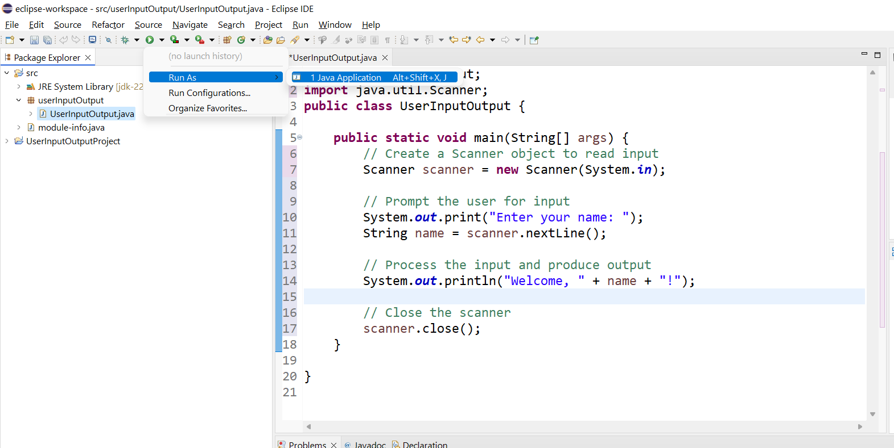
5. Run your Java program:
Right-click on your Java file (e.g., UserInputOutput.java).
Select Run As > Java Application.
This will execute your Java program, allowing you to enter your name and see the welcome message displayed in the console.

Slide 54
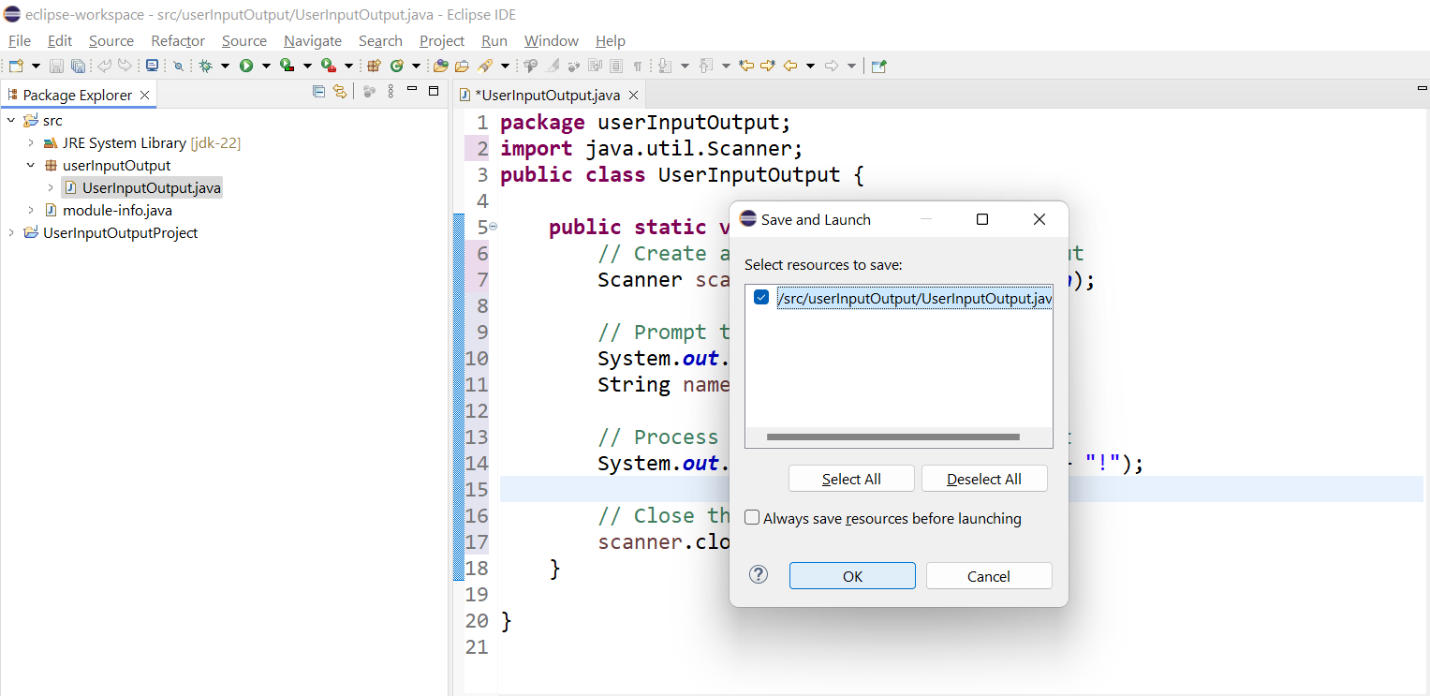
Select and Click on OK

Slide 55
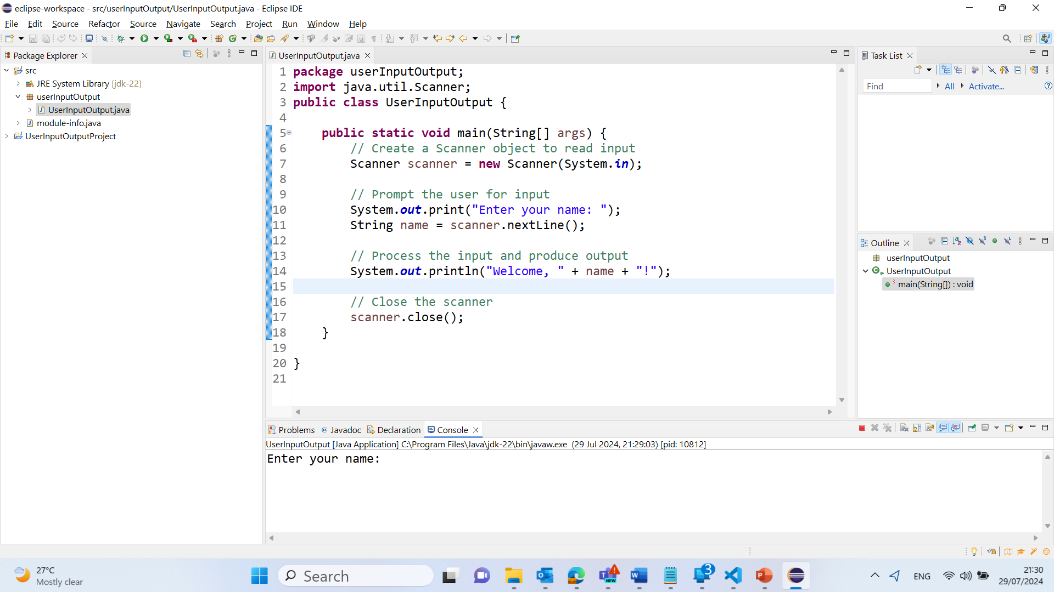
Output

Slide 56
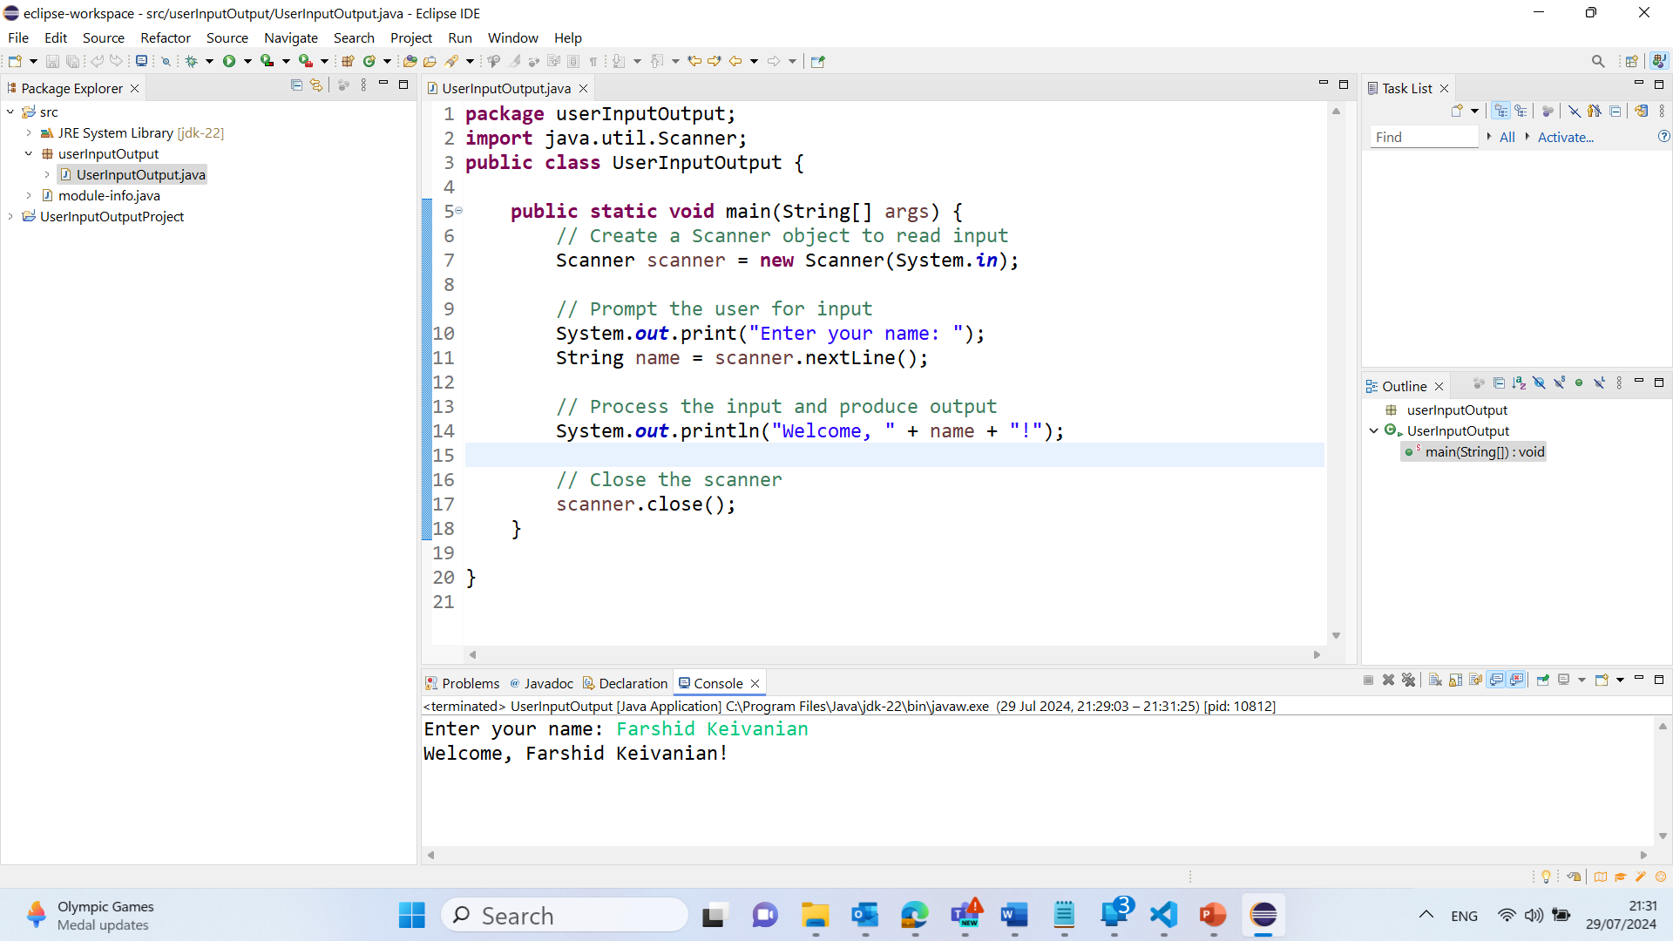
Output

Slide 57
For Python Programming
Recommendations:
Use Anaconda if:
You're new to Python/ML
You want a plug-and-play setup with JupyterLab
Use VS Code if:
You're already comfortable with Python and want a more advanced, customizable development workflow
Use Google Colab if:
You want to access your code from anywhere at anytime using your Gmail.

Slide 58
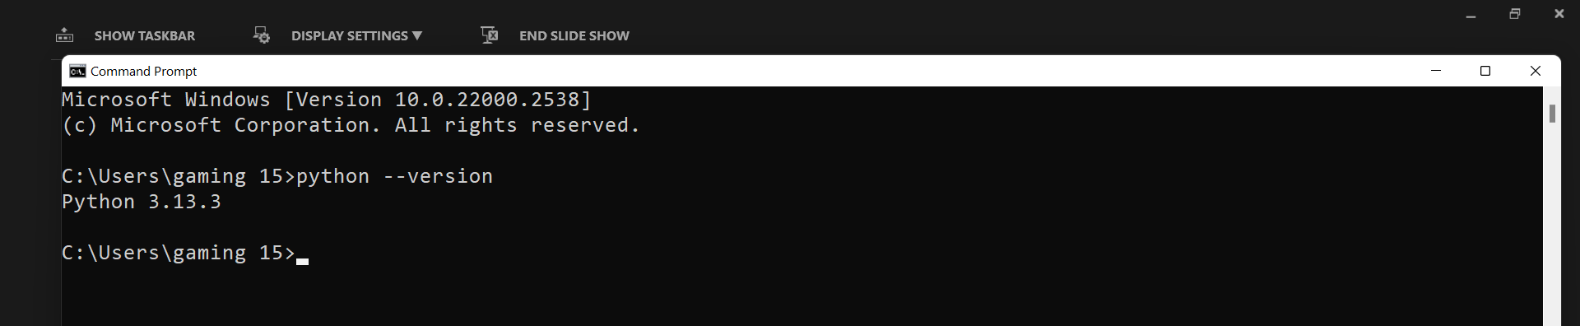
If you use Visual Studio Code
Test in terminal:
python --version
You have Jupyter support in VS Code Make sure you have the Jupyter extension installed
In VS Code → Extensions (Ctrl + Shift + X) → Search for "Jupyter" → Install
Make sure you have the required ML libraries installed, such as:
numpy
pandas
matplotlib
scikit-learn
seaborn (optional but useful)
jupyter
openml (optional for datasets)
Run this in terminal to install them all:
pip install numpy pandas matplotlib scikit-learn seaborn jupyter
You can run .ipynb notebooks in VS Code and execute Python code without issues.

Slide 59
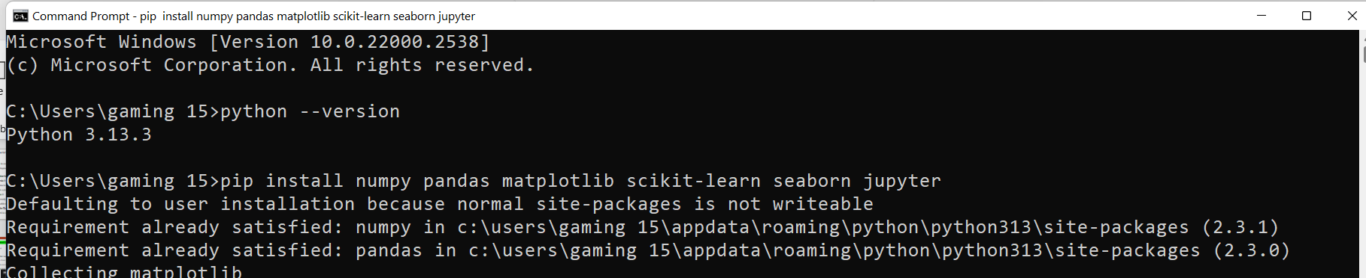
If you use Visual Studio Code
Test in terminal:
python --version
You have Jupyter support in VS Code Make sure you have the Jupyter extension installed
In VS Code → Extensions (Ctrl + Shift + X) → Search for "Jupyter" → Install
Make sure you have the required ML libraries installed, such as:
numpy
pandas
matplotlib
scikit-learn
seaborn (optional but useful)
jupyter
openml (optional for datasets)
Run this in terminal to install them all:
pip install numpy pandas matplotlib scikit-learn seaborn jupyter
You can run .ipynb notebooks in VS Code and execute Python code without issues.

Slide 60
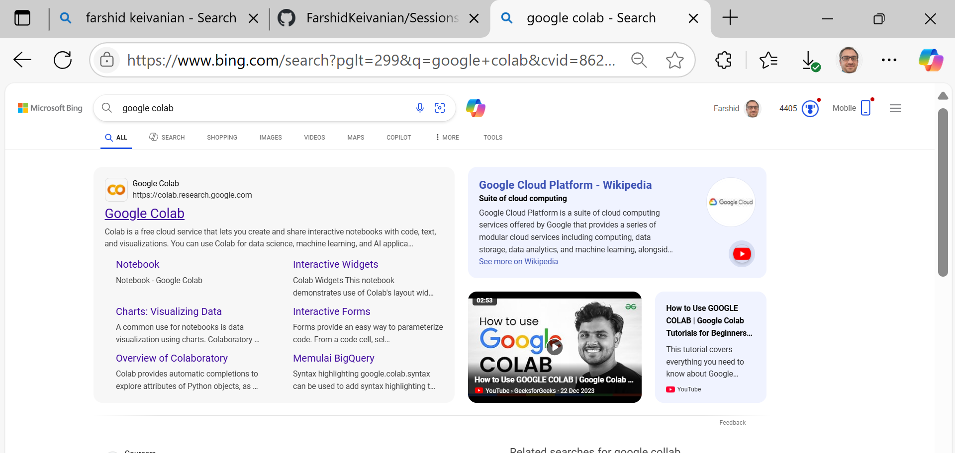
If you use Google Colab

Slide 61
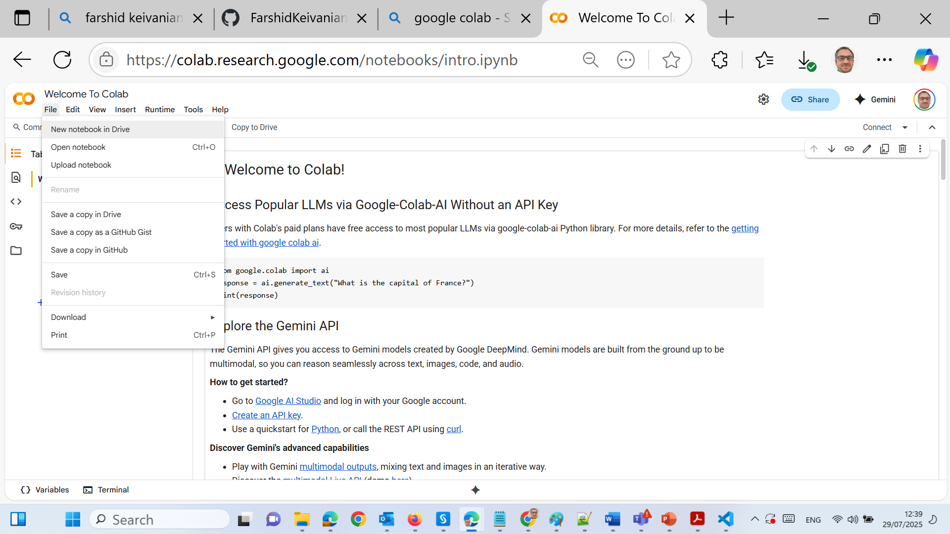
If you use Google Colab

Slide 62
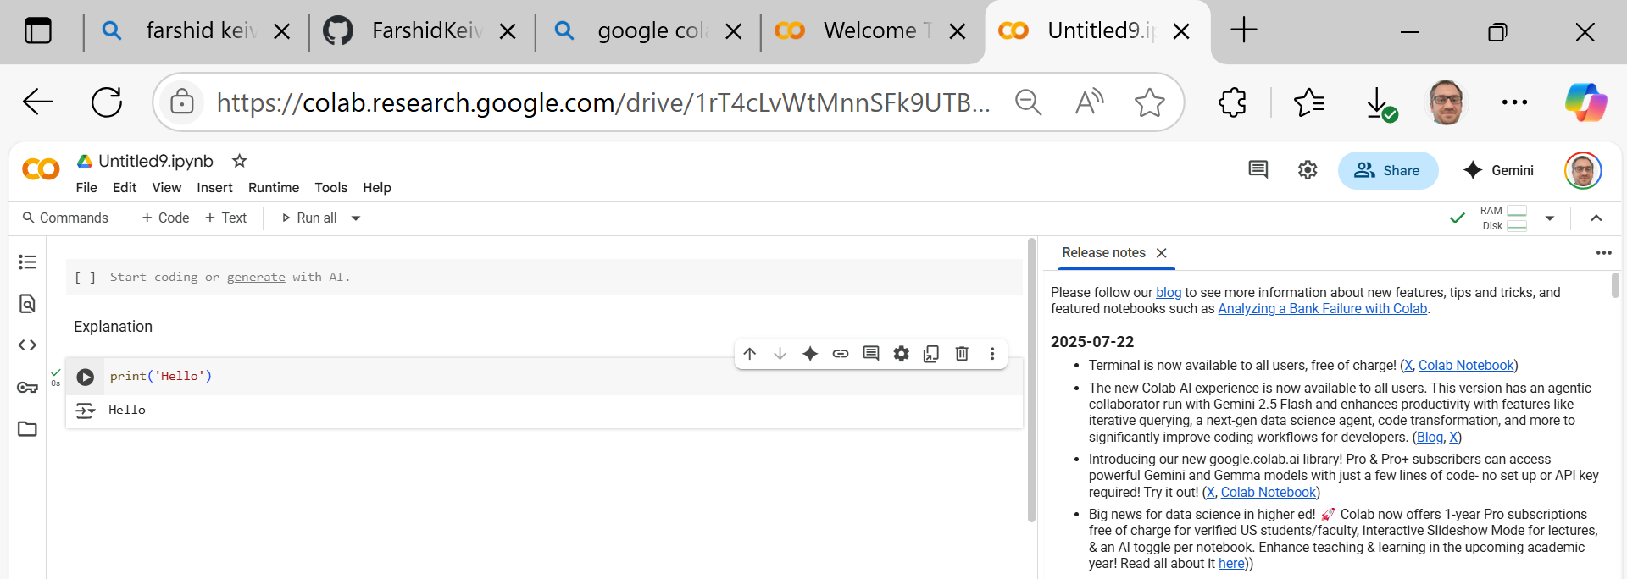
If you use Google Colab

Slide 63
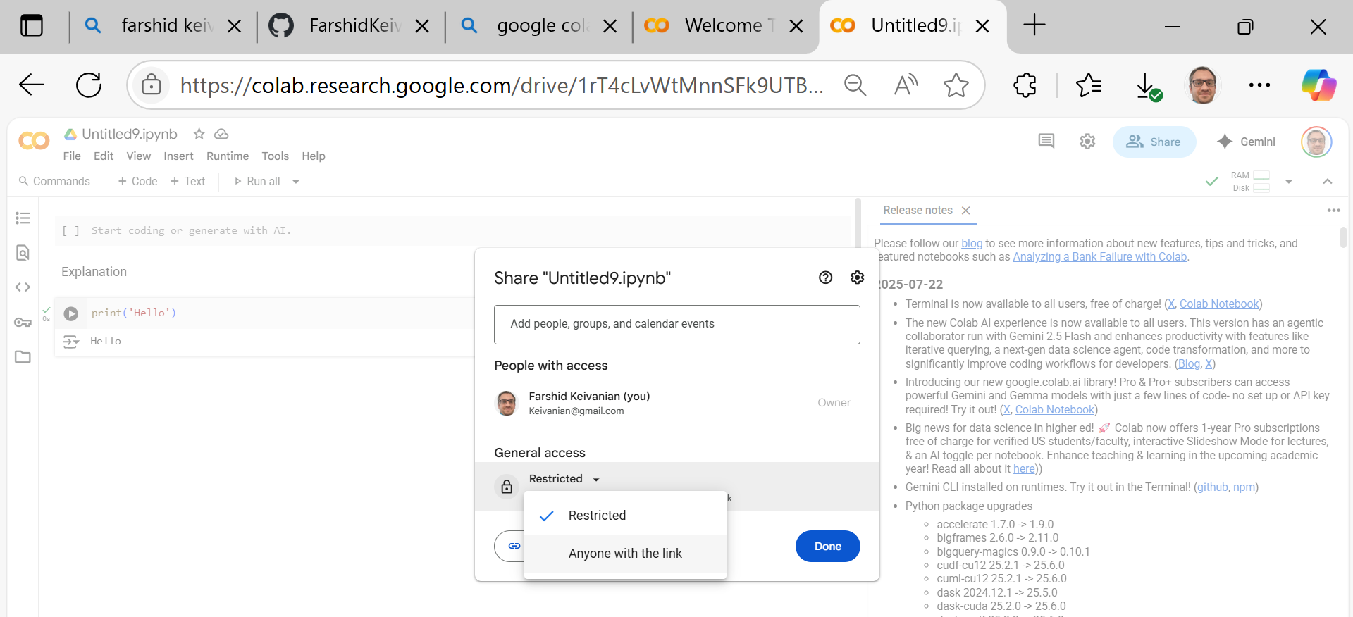
If you use Google Colab

Slide 64
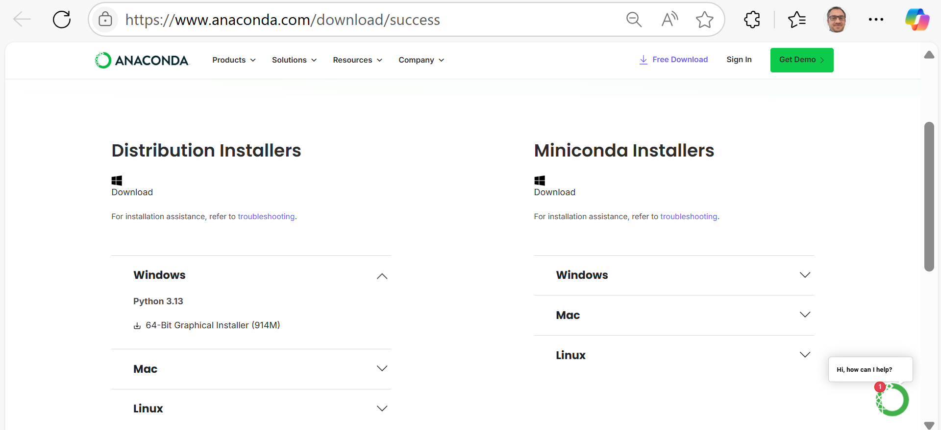
If you use Anaconda – Follow these steps:
Windows/Mac/Linux
Distribution Installers → Windows / Mac / Linux (based on their OS)

Slide 65
If you use Anaconda – Follow these steps:
Launch JupyterLab
From Anaconda Navigator, open JupyterLab.
It will open in a browser.
Create a new Python Notebook.
Write and Run Python Code
Use the grey code cells to write and run Python code.
Output appears below the code block.

Slide 66
Cloud Setup with Google Colab
Log into Google Drive with your Gmail account.
Create or open a Colab Notebook Go to: https://colab.research.google.com Or open from Google Drive > New > More > Colab.
Write and run Python code Use the Runtime menu to run cells.

Slide 67
How to Succeed in 32555
Weekly Routine for Success:
Watch the week’s lecture video
Complete the practice quiz
Attend and participate in your tutorial
Review and reflect on feedback
Contribute to group activities and GitHub commits

Slide 68
How to Succeed in 32555
Pro Tips:
Pick one language (Java or Python) and stick with it
Use UML tools to map your ideas before coding
Use Git for version control from the start
Reach out if you’re stuck — don’t wait until it’s too late!

Slide 69
Key Assessment Dates – Spring 2025
Task | Opens | Due | Weight
Quiz 1: Software Modelling | 9 Sep 5:00 PM | 12 Sep 6:00 PM | 15%
Part 1: Analysis & Design | 18 Aug | 14 Sep 11:59 PM | 15%
Quiz 2: Programming (Java/Python) | 21 Oct 5:00 PM | 24 Oct 6:00 PM | 15%
Part 2: Software Development | 29 Sep | 9 Nov 11:59 PM | 50%
Part 3: Project Showcase | 29 Sep | 7 Nov 11:59 PM | 5%

Slide 70
Week 1 – Requirements Analysis
What are software requirements?
Functional vs. Non-functional requirements
Use Case Diagrams and System Requirements Specs
Introduction to UML: Use Case & Activity Diagrams

Slide 71
Week 1 – Requirements Analysis
Tutorial (Lab 1):
Hands-on activity: Analyze a real-world scenario
Draw a use-case diagram using Draw.io or Visual Paradigm
Discuss requirements with your team

Slide 72
Week 1 – Requirements Analysis
Deliverables This Week:
Complete Week 1 Practice Quiz on Canvas
Submit Lab 1 solution

Slide 73
UML Diagrams
Draw.io is Suitable:
Free and browser-based — no installation needed
Supports all standard UML diagram types: use case, activity, class, sequence, etc.
Can save files to local storage or Google Drive
Easy to export as .png, .pdf, or .drawio files for submission

Slide 74
UML Diagrams
UML Tool Recommendation: You can use Draw.io (diagrams.net) to create UML diagrams like Use Case, Activity, or Class Diagrams. Export your diagrams as .png or .drawio and upload with your lab submission.

Slide 75

Happy Learning and Bright Futures Ahead! Dr. Farshid Keivanian Stay Connected: linkedin.com/in/farshid-keivanian github.com/FarshidKeivanian
Education is the most powerful weapon you can use to change the world. — Nelson Mandela

